Slide 1


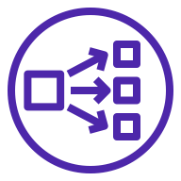





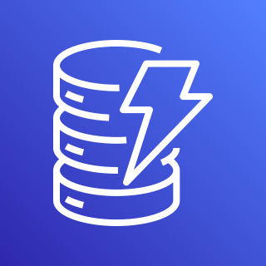


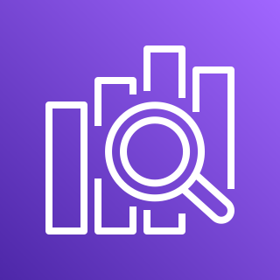
AWS Cloud
VPC
Arkime ELB
Suricata ELB
Wireshark ELB
Zeek ELB
Availability Zone
Availability Zone
Public subnet
Public subnet
Amazon S3
Bastion
NAT gateway
Bastion
NAT gateway
Private subnet
Private subnet
Auto Scaling group
Arkime
Arkime
Amazon
DynamoDB
Auto Scaling group
Traffic
mirroring
Traffic
mirroring
Suricata
Suricata
Auto Scaling group
Amazon
Elasticsearch Service
Wireshark
Wireshark
Auto Scaling group
Zeek
Zeek

